Slide 1
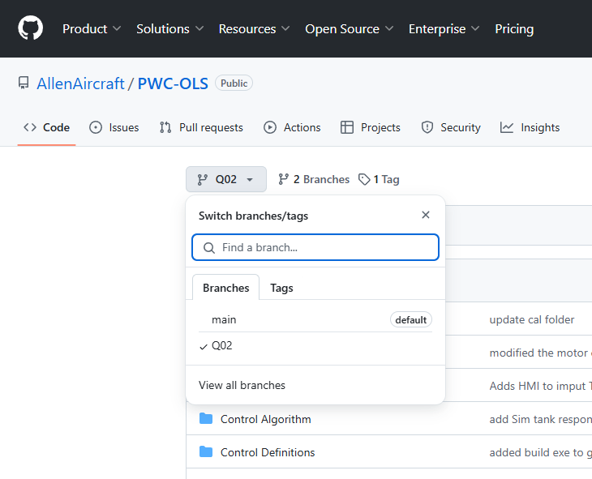
Step 2

Slide 2
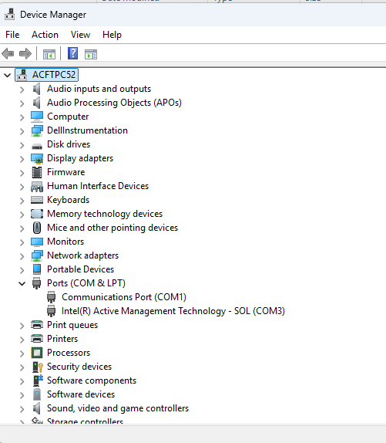
Step 2

Slide 3
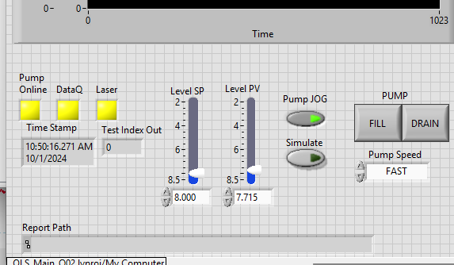
1
2
3
SIM button

Slide 4
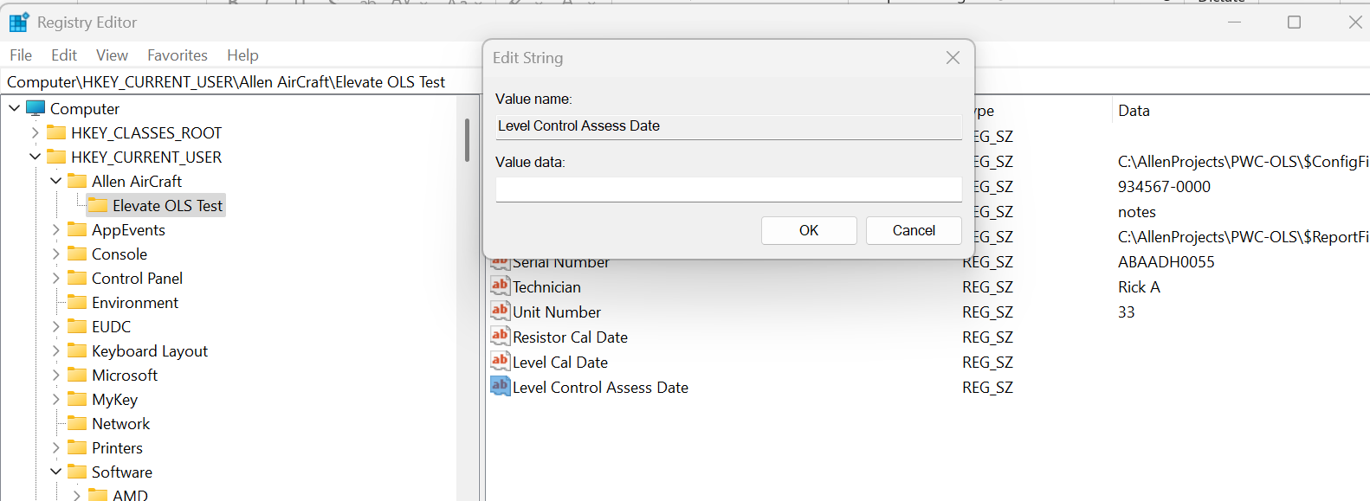
Enter date here
Navigate to this Key
Edit this Value

Slide 5
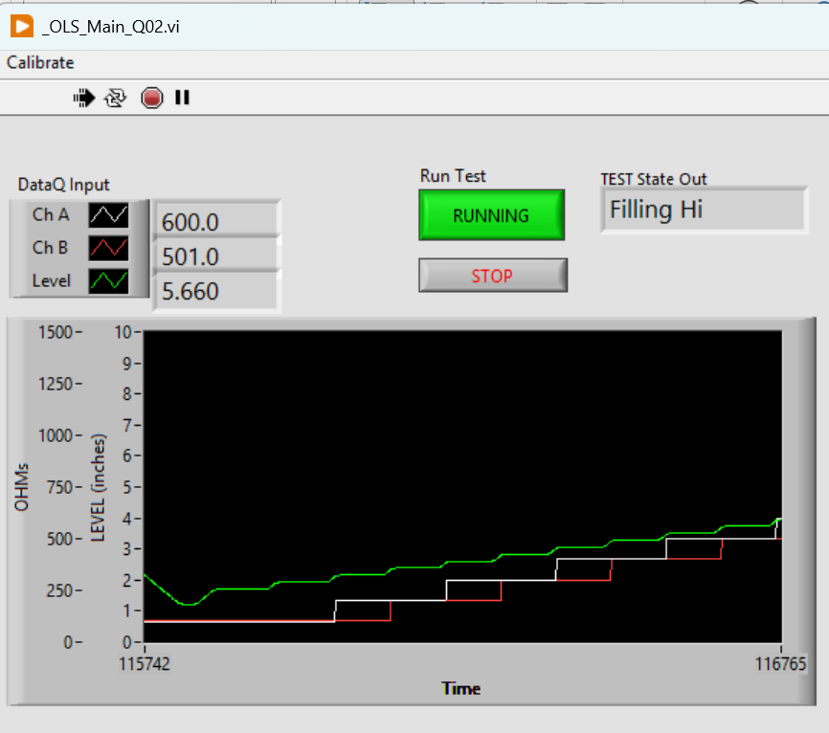
System State and Mode indicator
Click to START or END the automatic Test protocol
STOPS and Exit the application
GREEN Level
WHITE ChA
RED ChB

Slide 6
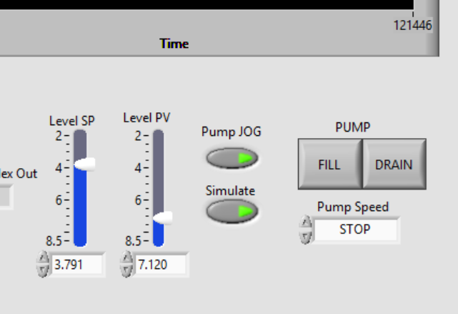
With Pump JOG button:
ON, the FILL and DRAIN buttons and the Pump Speed dropdown control the pump.
OFF then the Level (PV) goes to the SP.
Process Variable (PV) The measured Level.
Set Point (SP) The desired Level in automatic.
NOTE: SP, PV and Level indicate:
Tank is EMPTY when Level ~8.2”
Tank is FULL when Level ~ 2.4”
With Simulate ON, the Level PV and Green Plot should simulate the tank level.

Slide 7
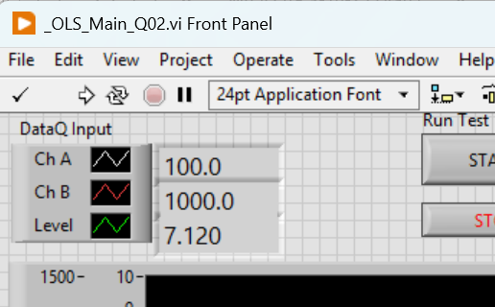
ChA Value.
ChB Value.
Level Value.

Slide 8
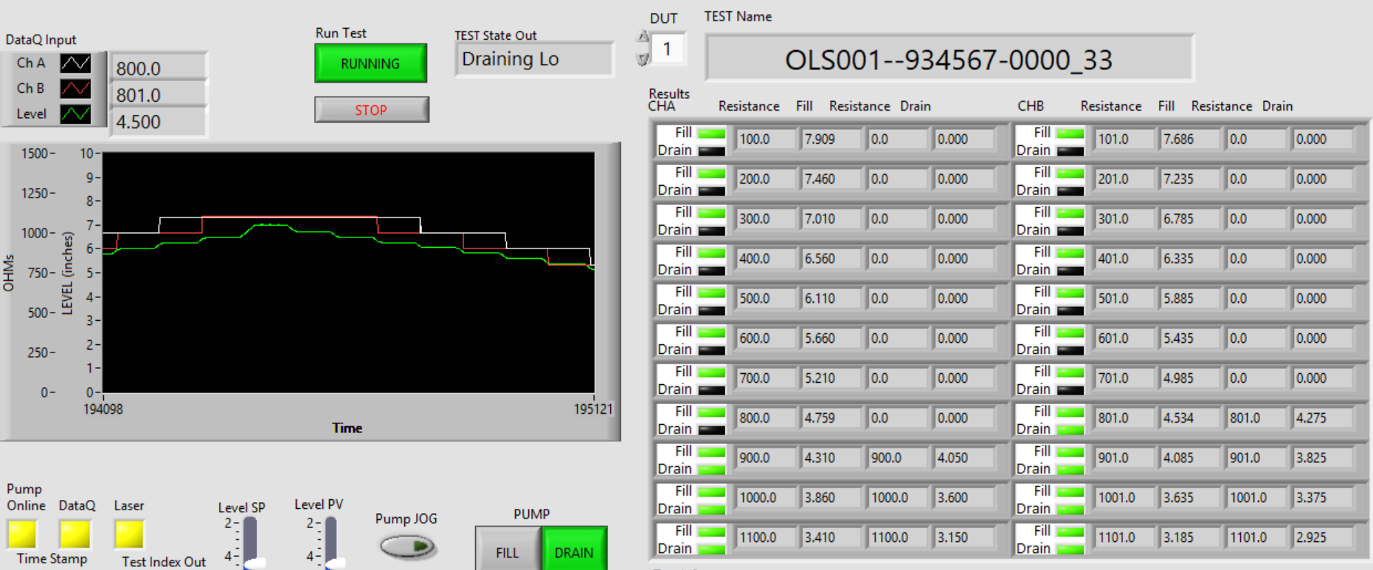
Measured Resistance
(4 places)
Measured Target Test Level
(4 places)
Current Test State
When Running (Green) The test protocol state machine sets the SP in automatic mode to create the stairstep level values.
FILL and DRAIN Status lights,
GREEN = PASS
RED = FAIL
YELLOW = Test Error
BLACK = Not Tested
ChA FILL
ChA DRAIN
ChB FILL
ChB DRAIN

Slide 9
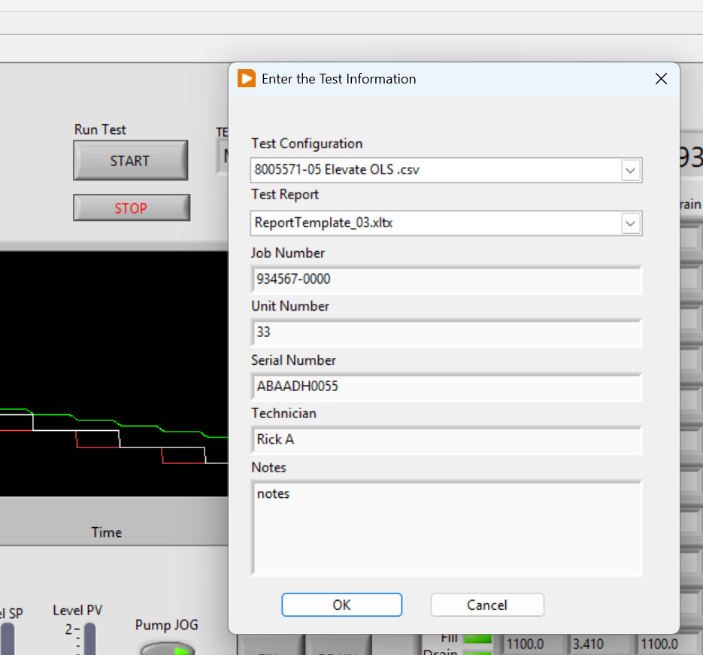
Test Information Dialog
STOP and Exit button.
Test Information Fields (7 Places)

Slide 10
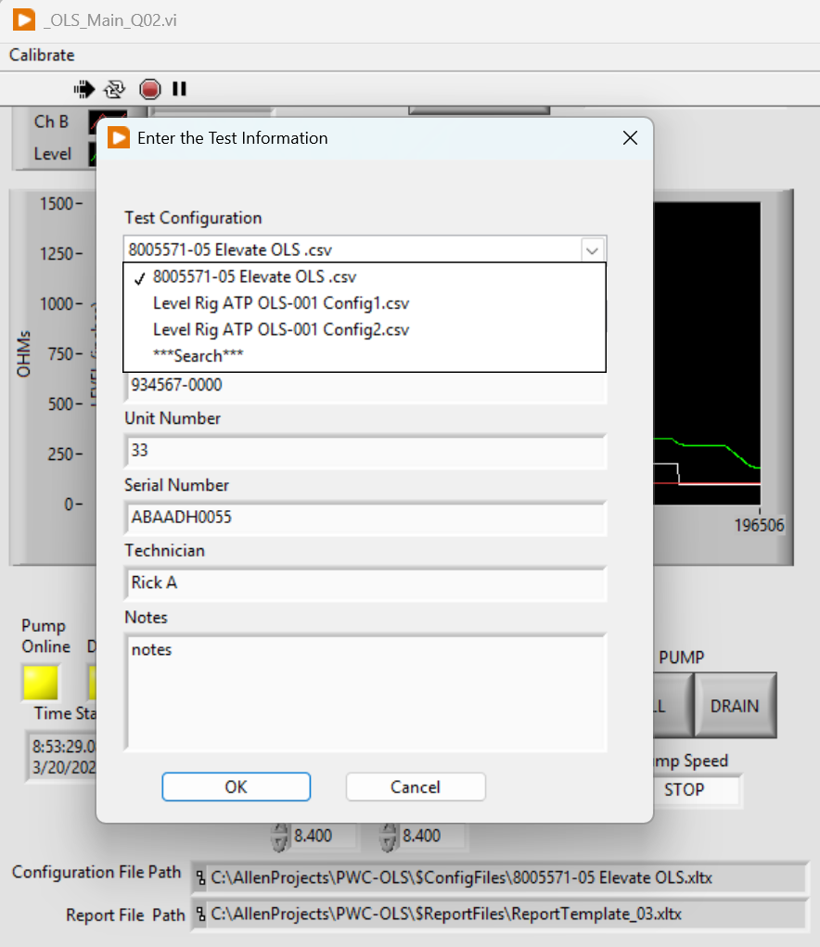
Config File Selection Field
Saved in Register
Currently Selected
Available Selection in current folder
Change Folder
Currently Selected
Full Path & Name

Slide 11
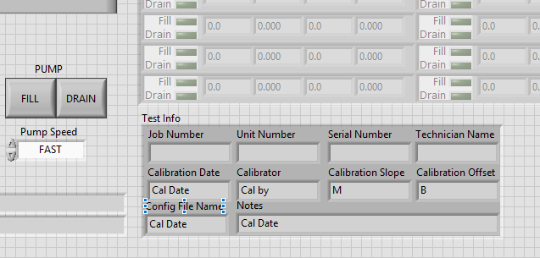
Test Information

Slide 12
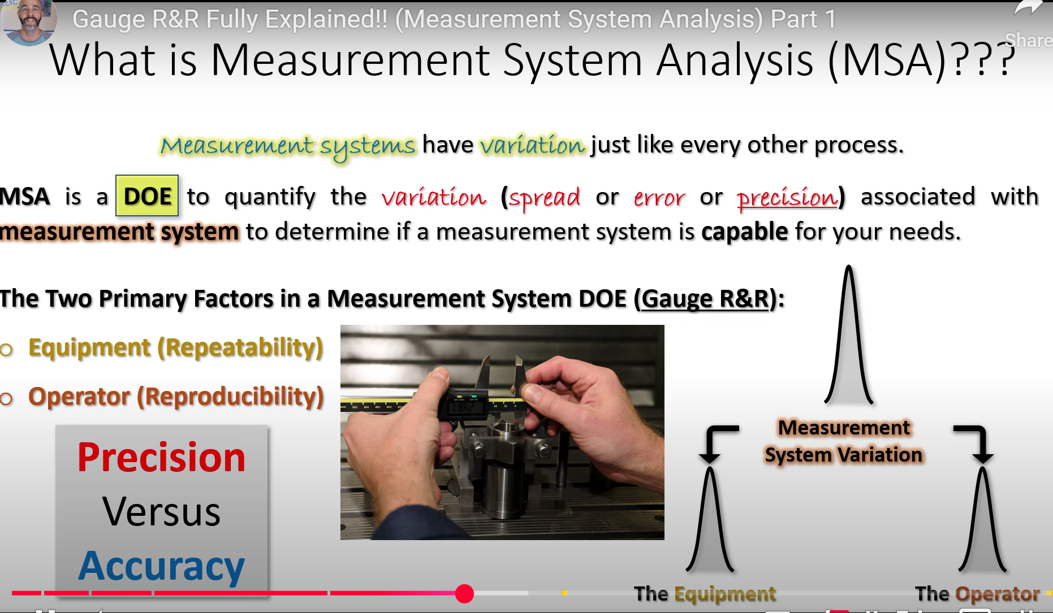
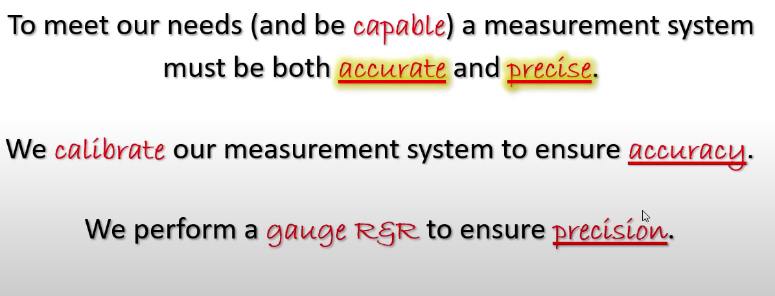
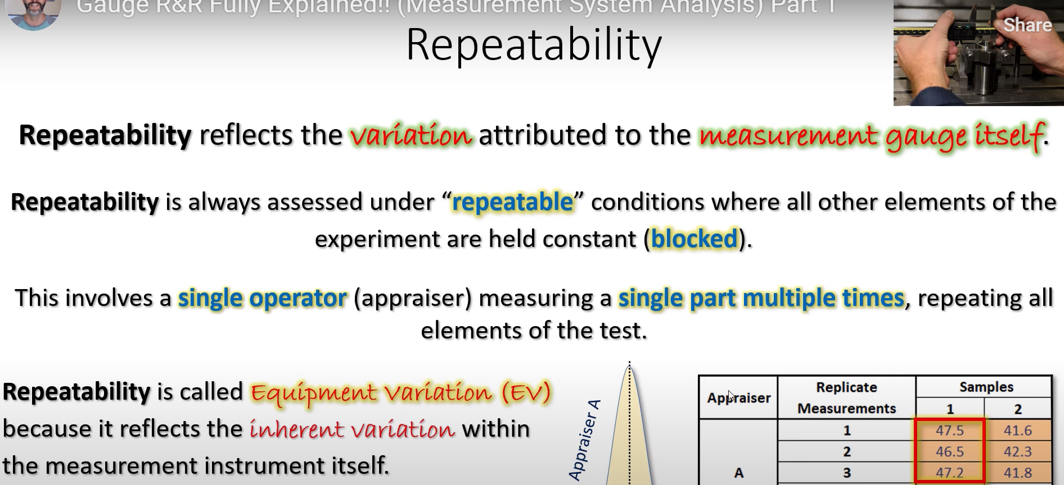
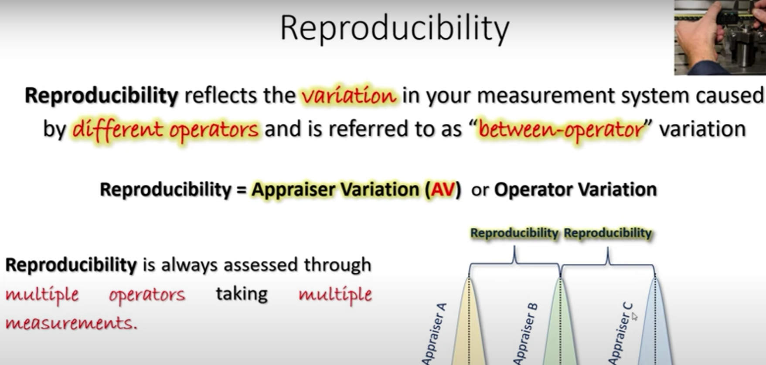

Slide 13
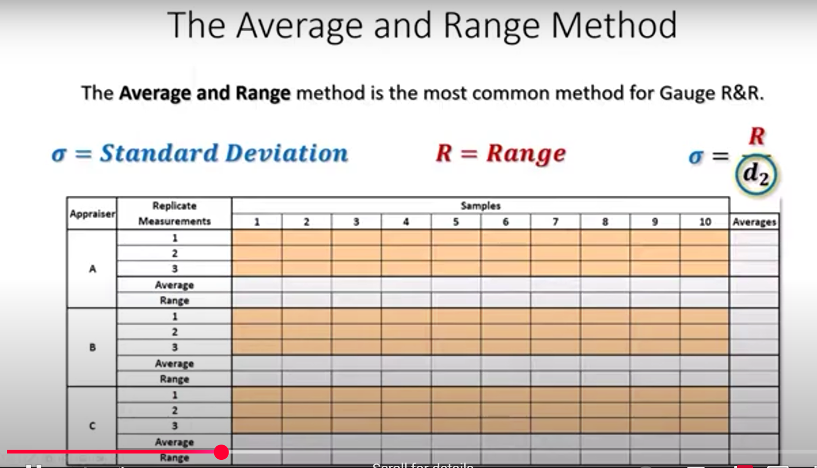
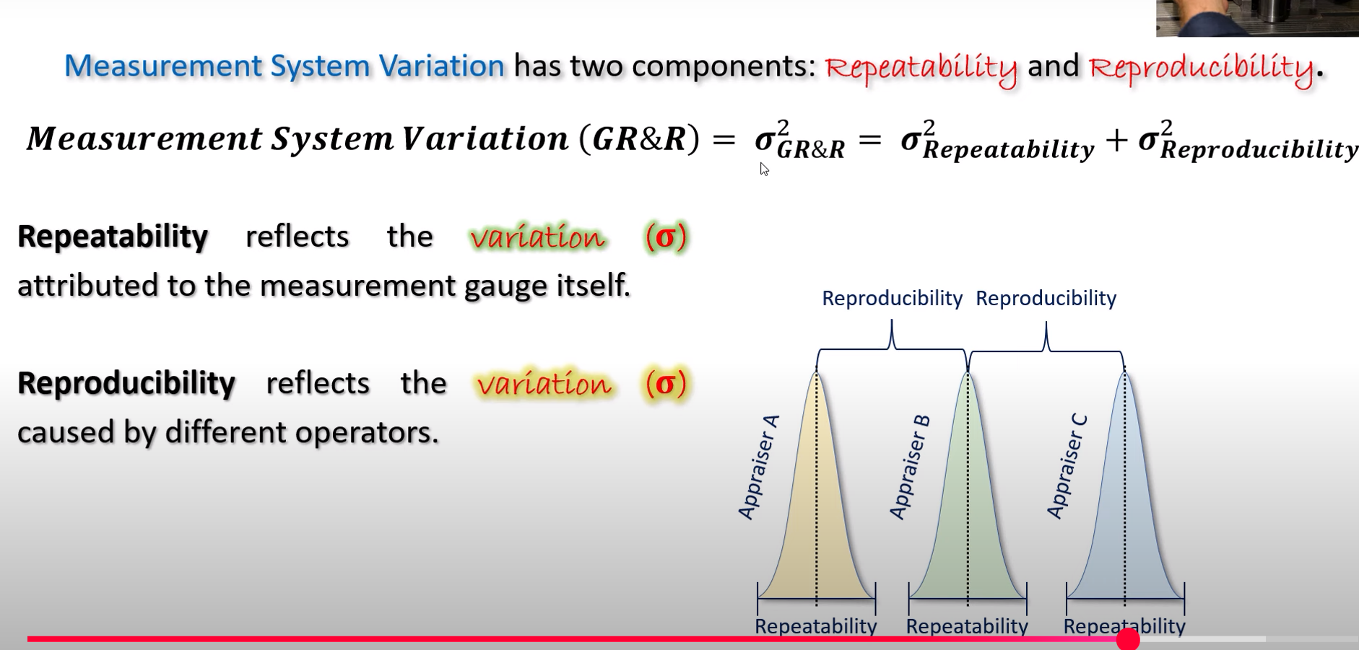
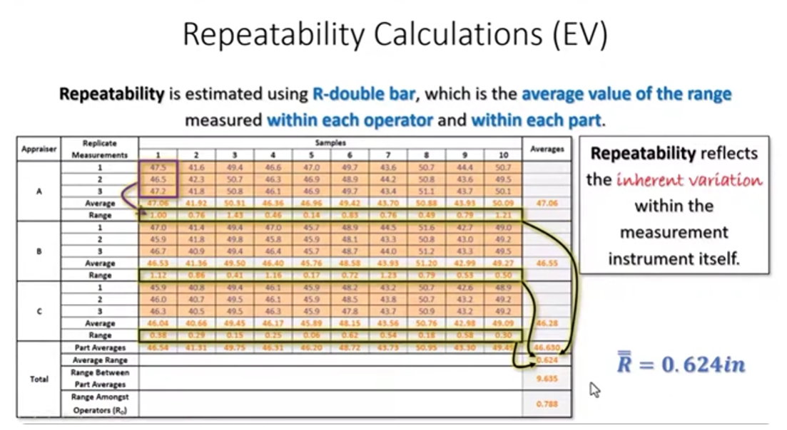
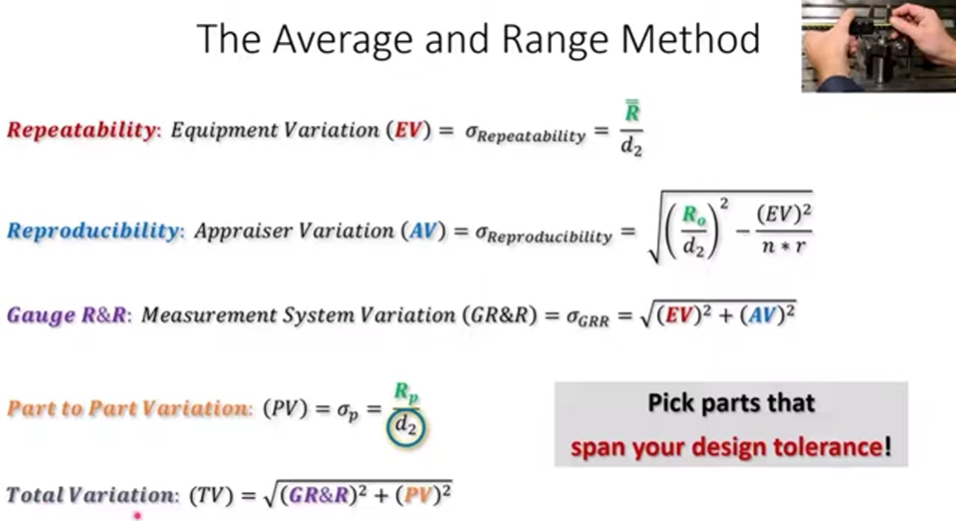

Slide 14
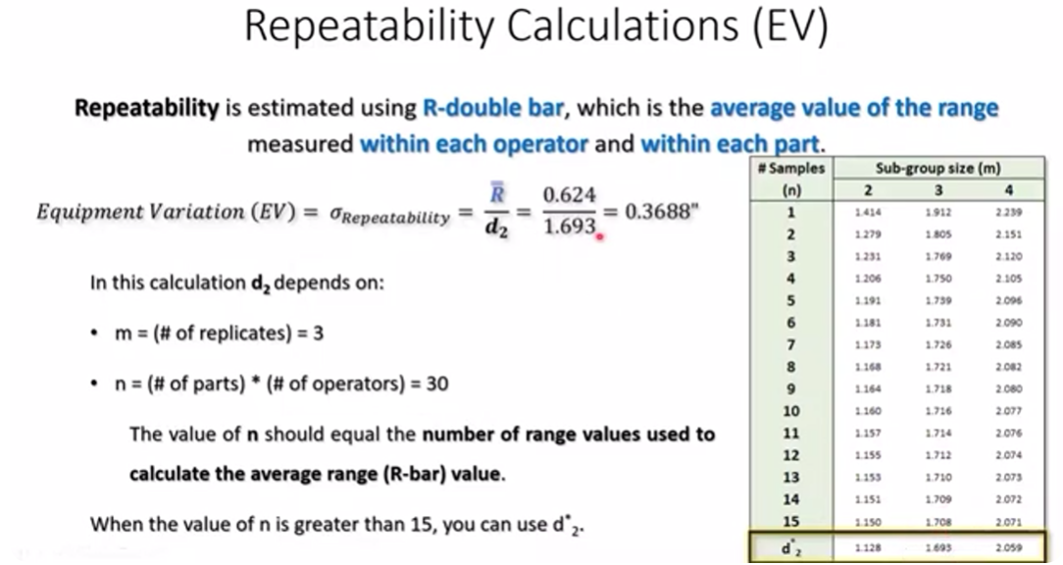
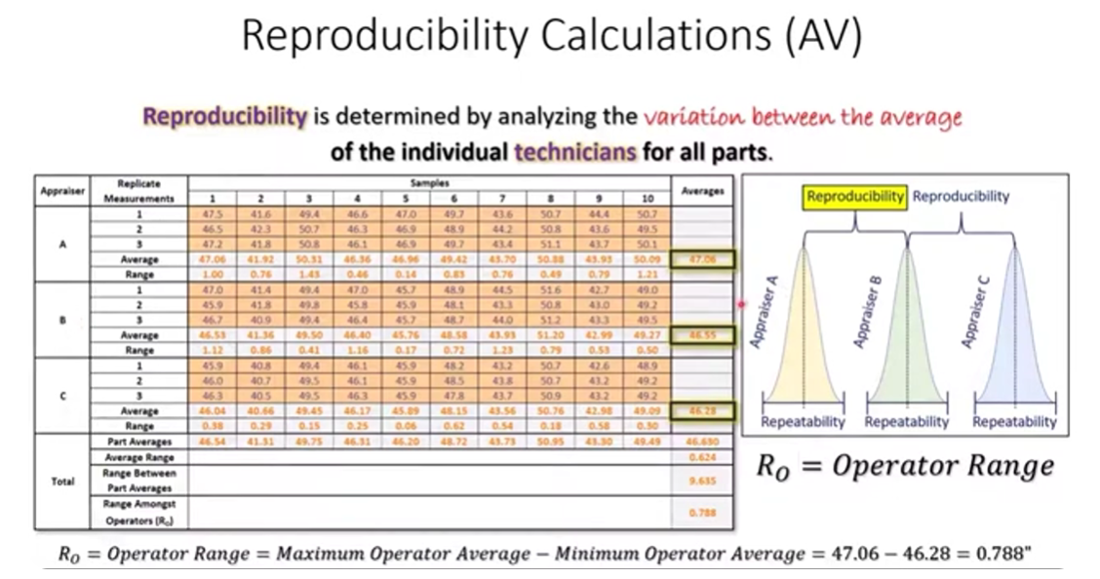
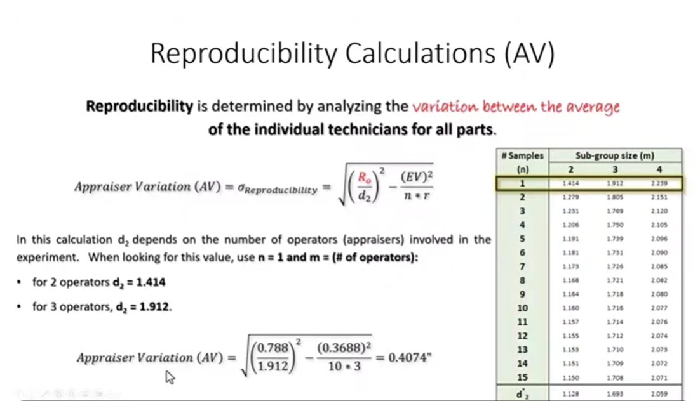
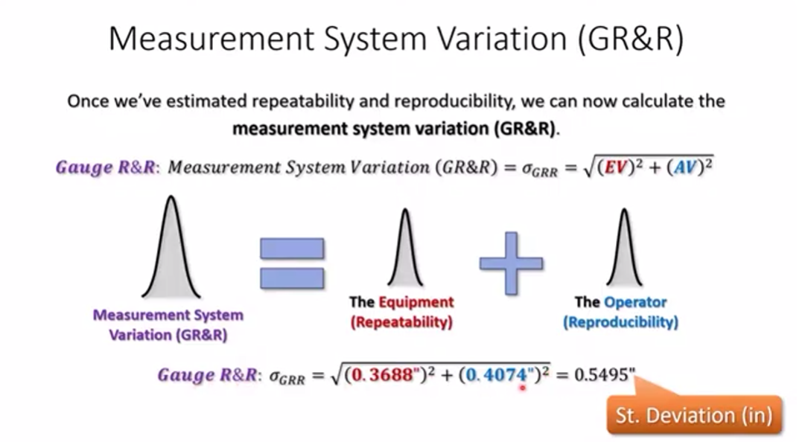

Slide 15
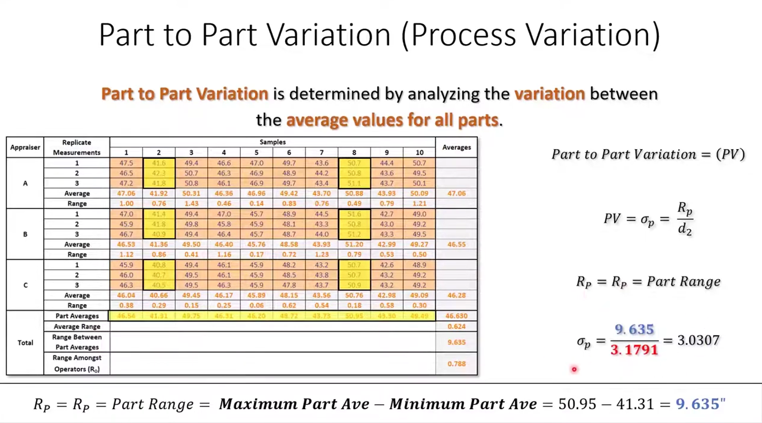
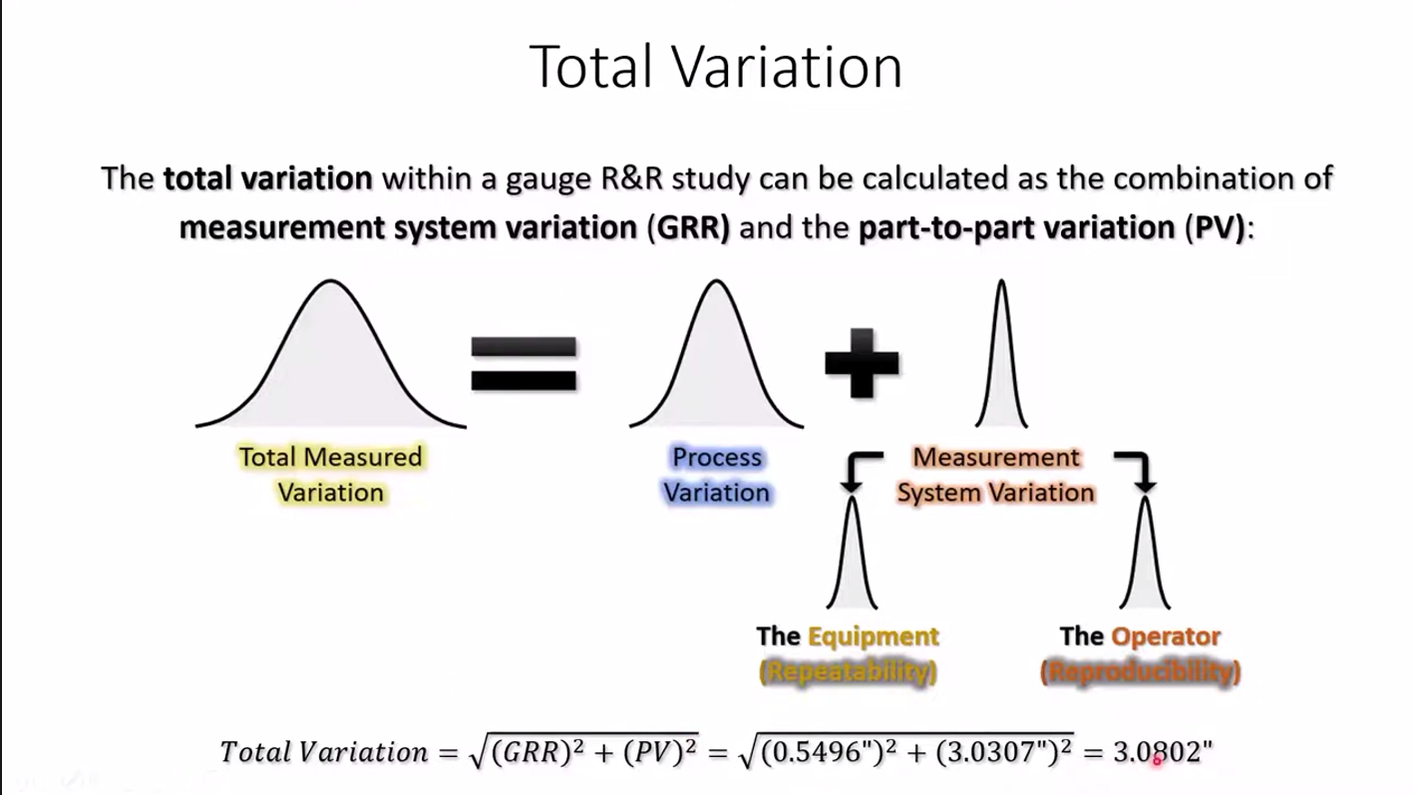
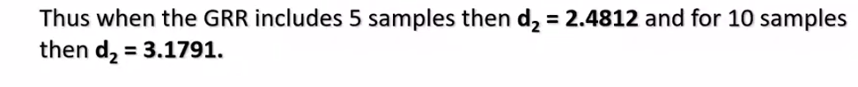
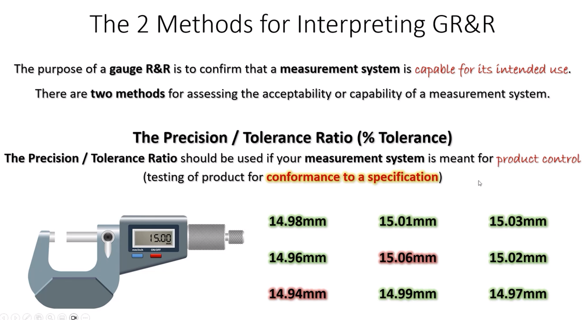
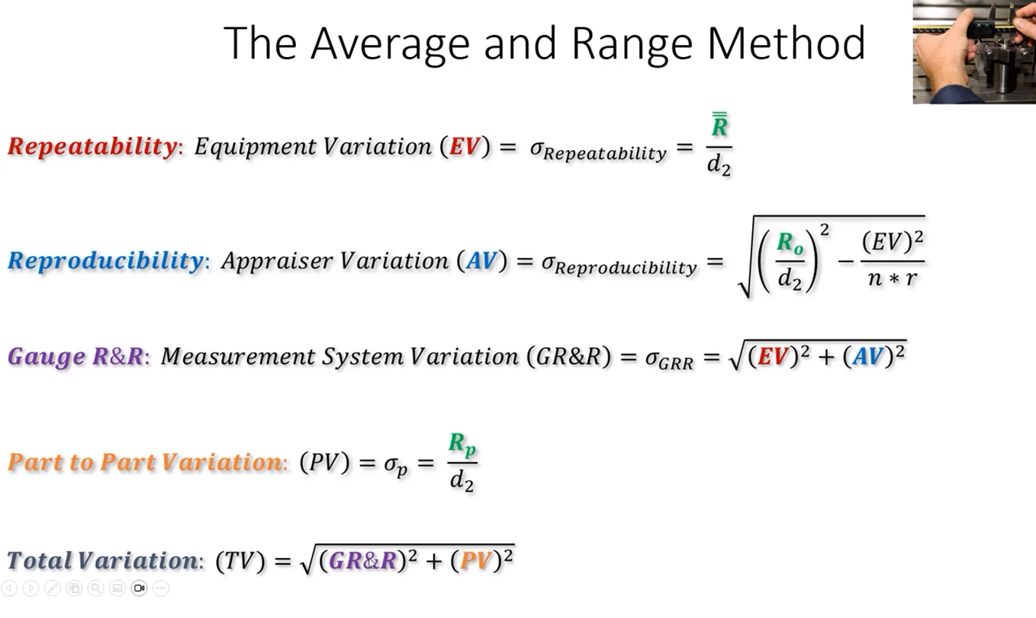

Slide 16
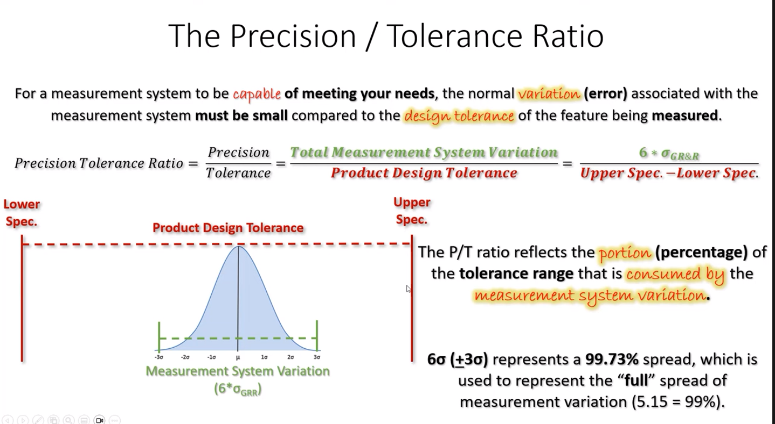
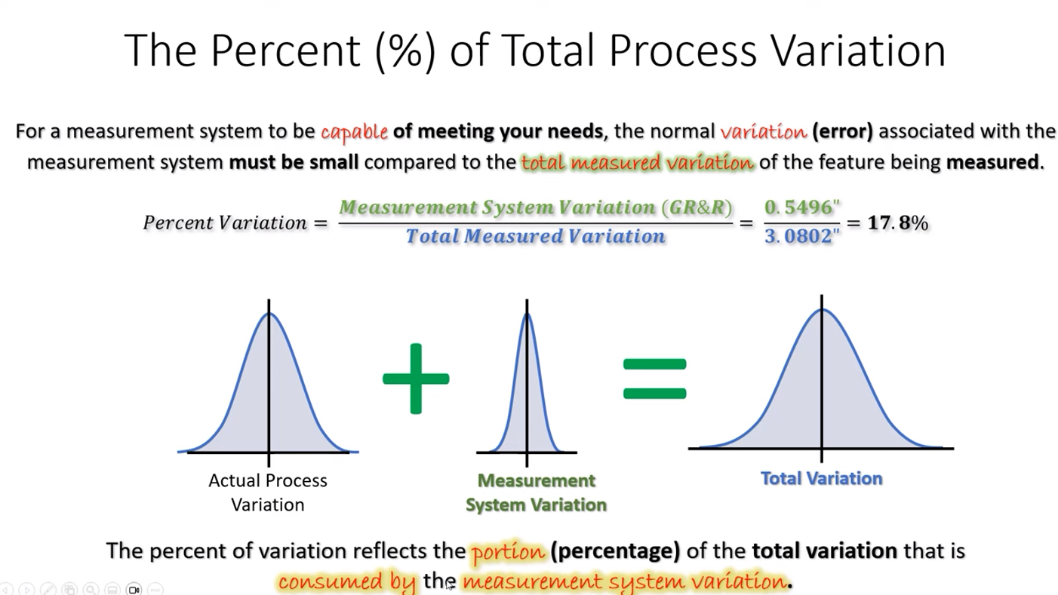

Slide 17
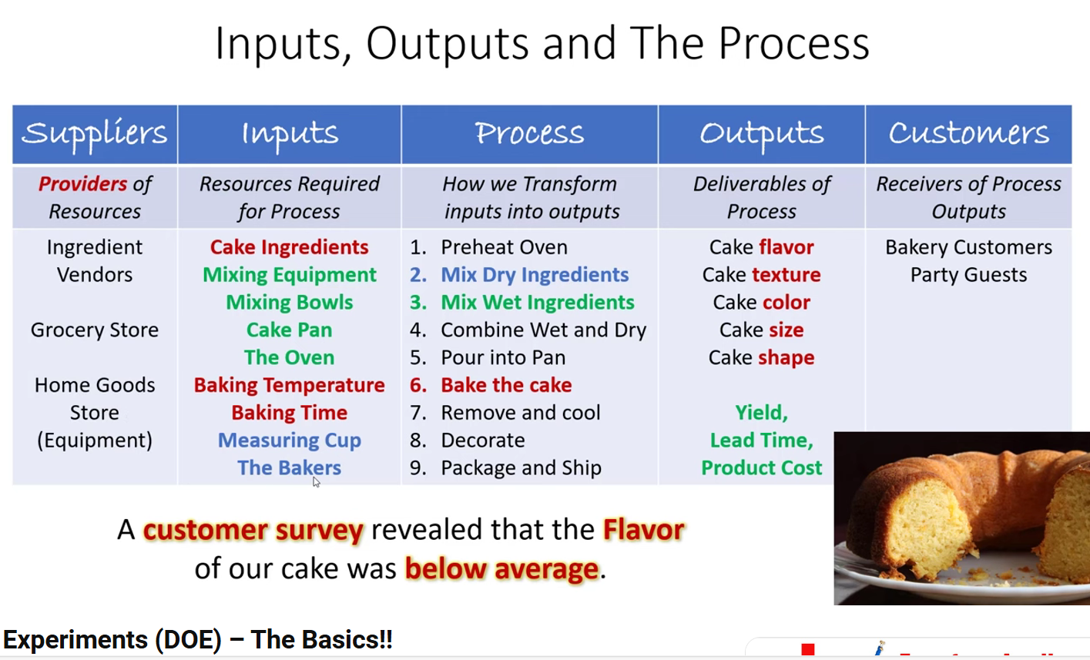
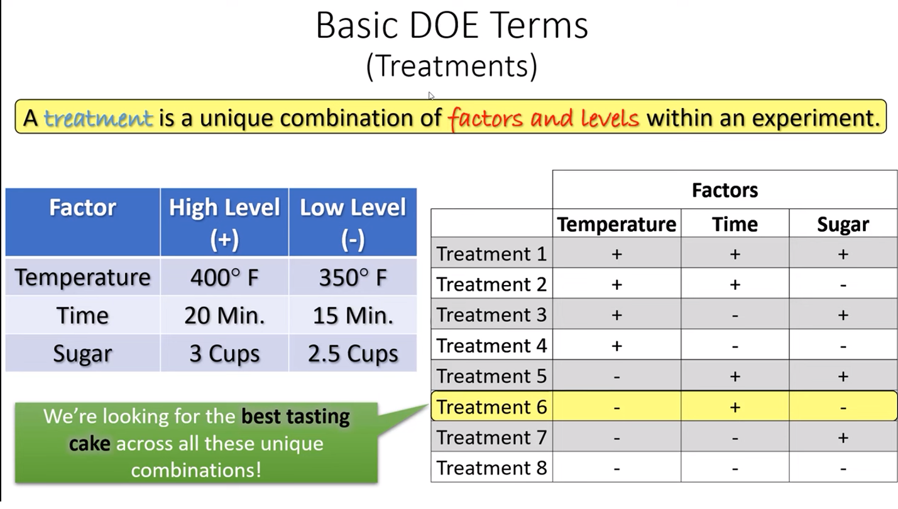
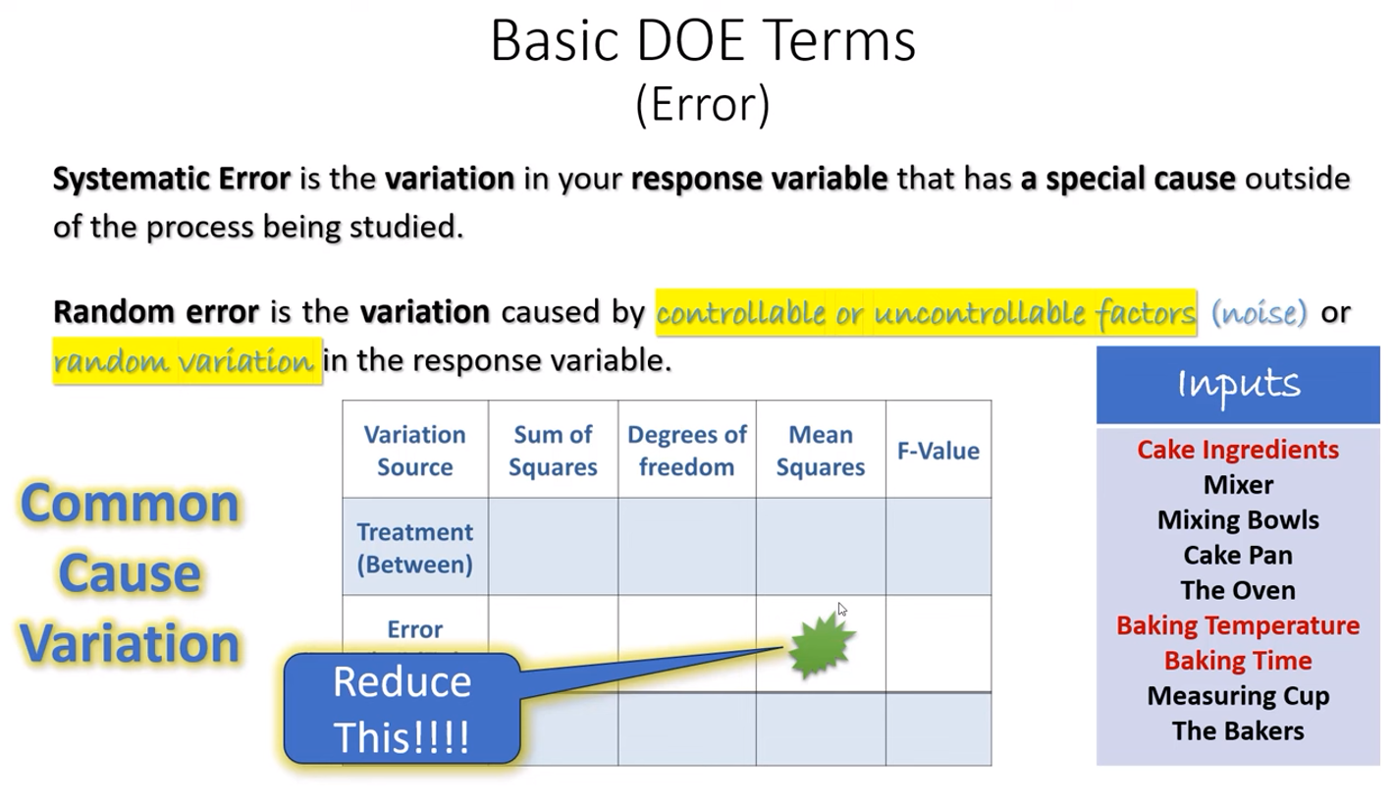
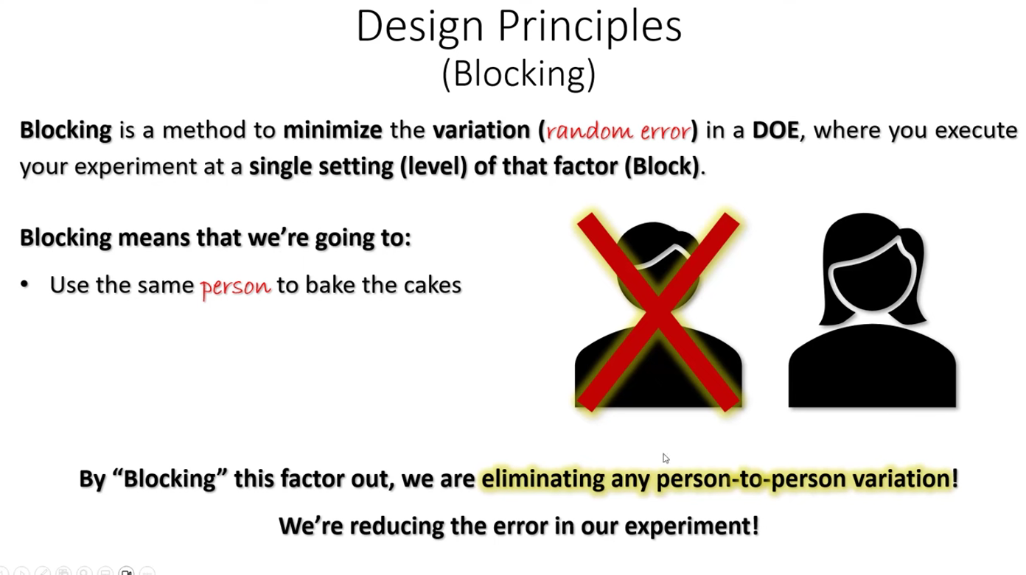
DOE SIPOC
DOE Design Matrix

Slide 18
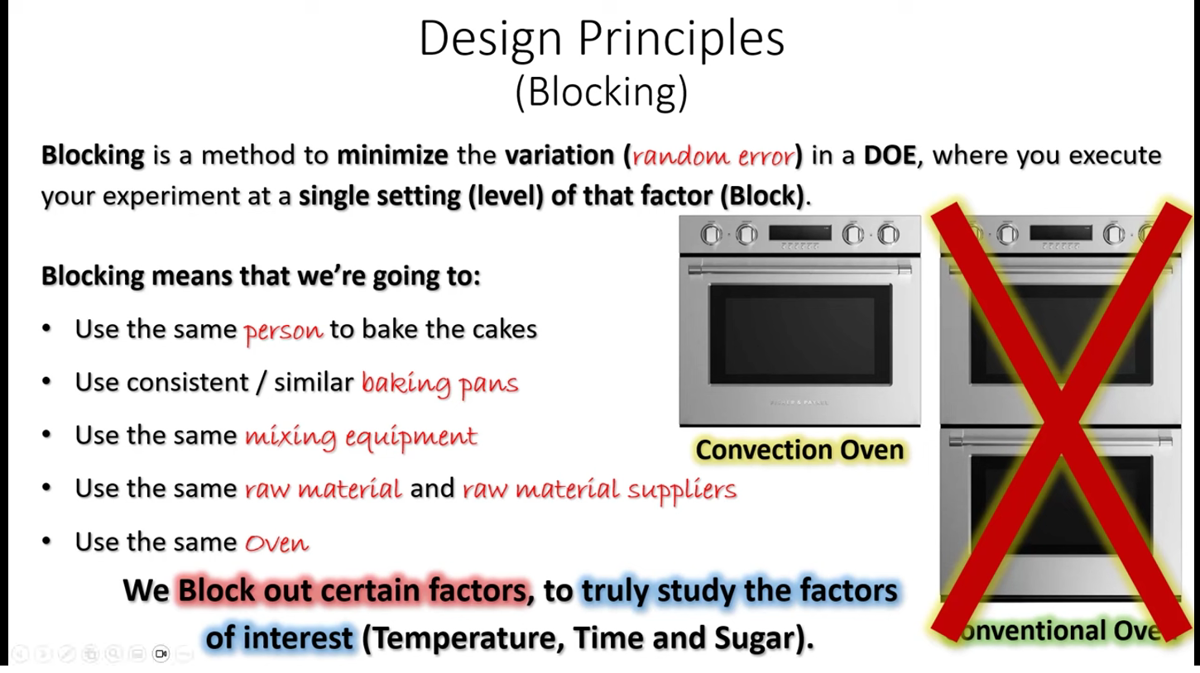
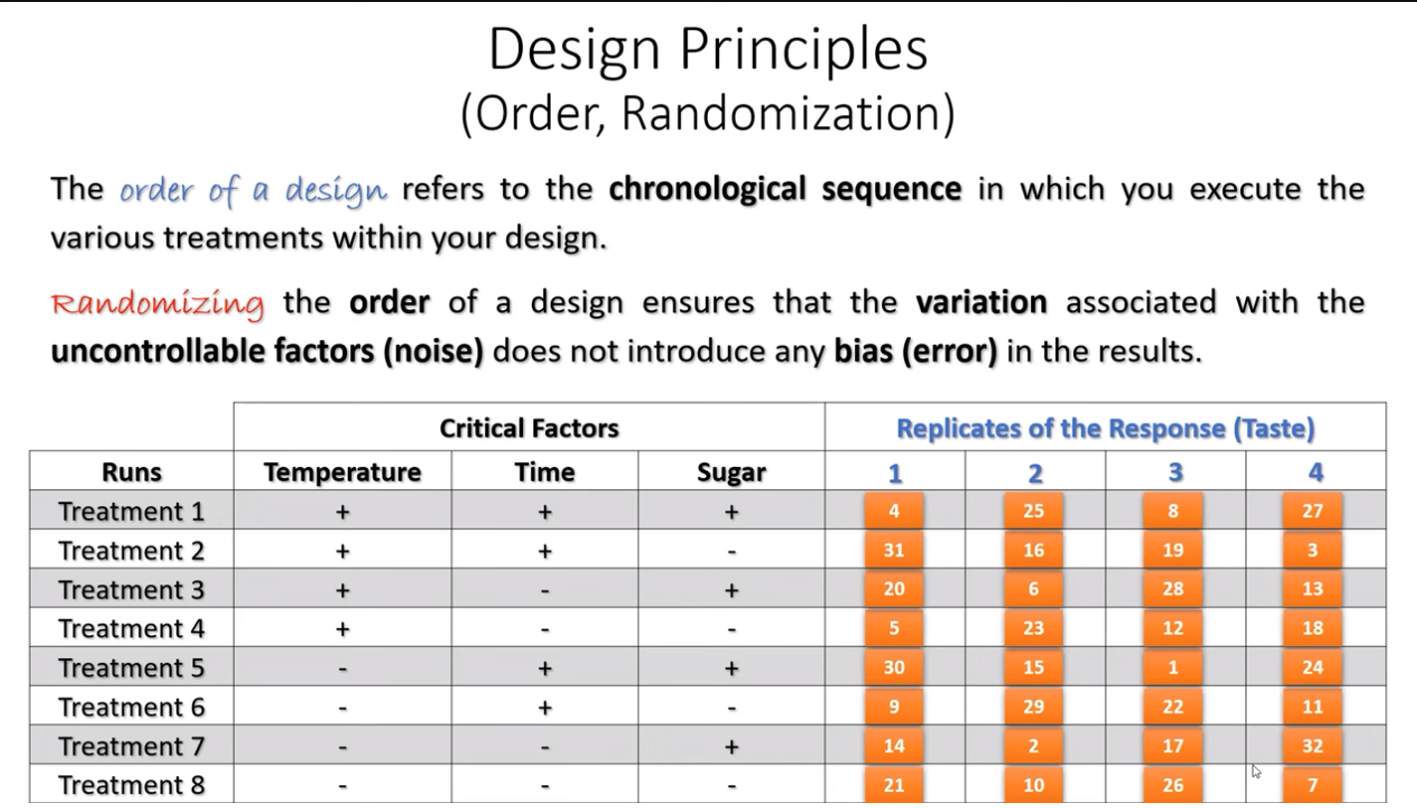

Slide 19
